Slide 1
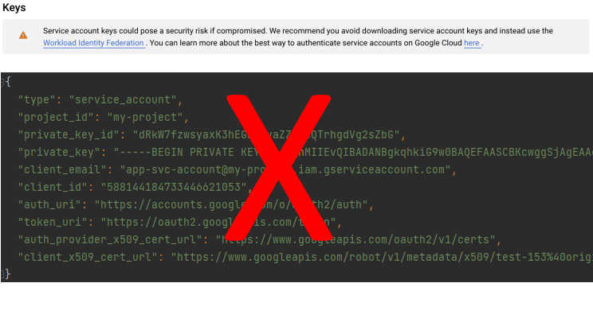
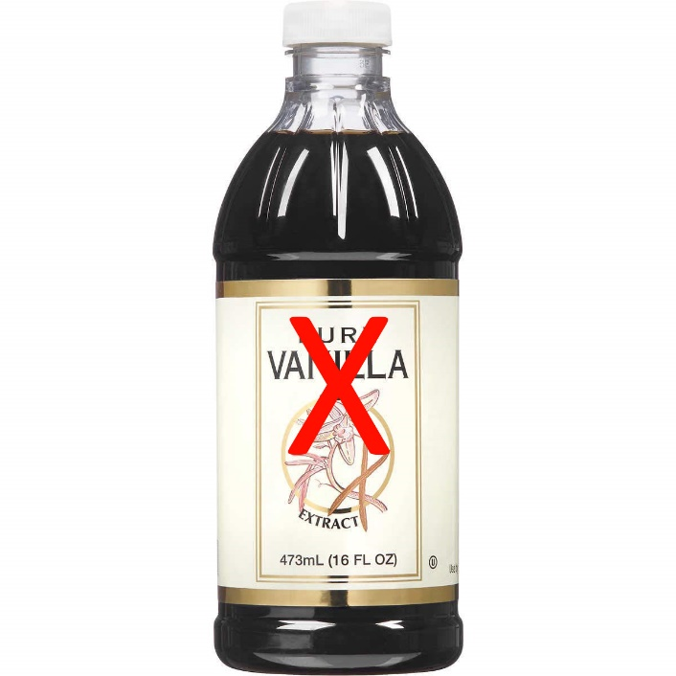
Where We’re Going we don’t need Secret Keys, or Store Bought Vanilla

Slide 2
What will be covered – Part 1
Service Identity
The service identity problem
The problem with keys
The service identity solution
Keyless service identity in AWS, GCP, and Azure
Each platform’s approach
Approaches to maximize keyless auth for each platform
Service identity wrap-up
Onwards to part 2, Vanilla!
Notes:
I’m not going to deep dive into any specific solutions, but I will give some examples.
This is to get you excited to look for keyless solutions and get you familiar with some of the major components, approaches

Slide 3
The service identity problem
The things you build need to authenticate to APIs
Your own APIs
Your cloud platform’s APIs
Other people’s APIs
Your employer may use multiple cloud platforms
Service identities need some kind of credential for authentication
Notes:
Your programs don’t exist in a vacuum
You may think you only use one cloud provider for a product, but what about business systems? What about the SaaS services you consume?

Slide 4
The problem with keys
Long lifetime
More opportunities to mishandle
You must provide the secure storage
You must provide the rotation mechanisms
You must provide the solution for accessing the key
That’s a lot of YOU for a cloud platform!
Notes:
Think about the key that unlocks the door to where you live
You have to keep it somewhere, protect it, re-keying your lock takes effort
What if instead someone just waited outside your place and handed you a short lifetime token instead
From the perspective of your app, that’s what happens when you use a keyless solution

Slide 5
The service identity solution
Leverage the keyless IAM solutions of your cloud provider!
They don’t want you to use keys either
They build these features right into their auth library, SDK
Relies on short lived tokens
OpenID Connect (OIDC) is common for federation
OpenID Connect is an identity layer that runs on top of OAuth2
OpenID Connect used for authentication, OAuth2 used for authorization
Notes:
Your cloud provider has already done a tremendous amount of work so that you don’t have to use secret keys

Slide 6
Service Identity in AWS

Slide 7
Amazon Resource Names (ARN)
The ARN is an identity attached to everything
Users, roles, EC2 instances, Lambda functions, S3 buckets, etc. all have ARNs
ARNs are used in policies either to specify principals or resources
No matter what, ARNs will be part of your keyless auth in AWS
arn:partition:service:region:account-id:resource-id
arn:partition:service:region:account-id:resource-type/resource-id
arn:partition:service:region:account-id:resource-type:resource-id
Notes:
To understand identity in AWS we first need to talk about Amazon Resource Names, or ARNs.
https://docs.aws.amazon.com/general/latest/gr/aws-arns-and-namespaces.html

Slide 8
AWS IAM Policies
Two primary policy types are identity-based and resource-based
Identity-based policies are attached to users and roles
Resource-based policies are attached to resources
The combination of all applicable policies sets the effective permissions
Notes:
There are multiple types of IAM policies and we’re not going to talk about them all.
Two primary types.
Combination of all becomes the effective permissions.
https://docs.aws.amazon.com/IAM/latest/UserGuide/access_policies.html

Slide 9
Resource-based policy only
In some cases, a resource-based IAM policy is all you need
Typical with fully managed services
You’re forced to use this option anyways
Examples include:
CloudFront w/Origin Access Identity reading from S3 backend
Amazon EventBridge publishing to Amazon SQS
Notes:
This is the most basic type of keyless auth in AWS
https://docs.aws.amazon.com/AmazonCloudFront/latest/DeveloperGuide/private-content-restricting-access-to-s3.html
https://docs.aws.amazon.com/eventbridge/latest/userguide/eb-use-resource-based.html

Slide 10
Role + IAM policy
The rest of Amazon’s keyless auth is based on this combination
Assign your service a role, then use IAM policy to grant permissions
Examples across Amazon’s portfolio:
Lambda execution role
EC2 instance profile
ECS task IAM role
API Gateway for your own service to service auth!
Notes:
AWS takes a very role centered approach. It’s not just that roles get used, it’s that the role itself is the path to keyless auth with the different “AssumeRole” actions.
https://docs.aws.amazon.com/lambda/latest/dg/lambda-intro-execution-role.html https://docs.aws.amazon.com/AmazonECS/latest/developerguide/instance_IAM_role.html
https://docs.aws.amazon.com/AmazonECS/latest/developerguide/task-iam-roles.html
https://docs.aws.amazon.com/apigateway/latest/developerguide/api-gateway-control-access-using-iam-policies-to-invoke-api.html

Slide 11
OIDC + Role + IAM policy
Used when federation is required
Connecting from outside AWS into AWS
Elastic Kubernetes Service
Create OIDC identity provider in IAM
Use Role + IAM policy to cover authorization
Federated identity is granted sts:AssumeRoleWithWebIdentity action on role
Examples of usage:
Connecting to AWS from GitHub Actions
Connecting from a service in another cloud provider like GCP or Azure into AWS
Notes:
https://docs.aws.amazon.com/IAM/latest/UserGuide/id_roles_providers_create_oidc.html
https://github.com/marketplace/actions/configure-aws-credentials-action-for-github-actions#assuming-a-role
https://docs.aws.amazon.com/IAM/latest/UserGuide/id_roles_providers_create_oidc.html

Slide 12
Service Identity in GCP

Slide 13
Google service accounts
Service identities in GCP come from assigning service accounts
service-account-name@project-id.iam.gserviceaccount.com
Projects contain default accounts, these should not be used
You can disable this with constraints/iam.disableServiceAccountCreation organization policy
Service accounts can then be assigned roles at the organization, folder, project, or resource level
Like setting permissions on folders and files
Inheritance, each layer down adds permissions
Notes:
GCP is organized with the organization at the highest level, then below the organization you have folders and projects, then within projects there are resources

Slide 14
Assigned service account
Application Default Credentials (ADCs) is the GCP term for the way you can use the assigned service account
Google’s libraries always default to keyless auth using ADCs
Can be used for both accessing GCP services and authenticating to applications
Identity Aware Proxy, API Gateway can be used for service to service auth
Cloud SQL IAM database authentication extends service accounts to MySQL or Postgres
Examples within GCP include:
Cloud Functions
App Engine
Compute Engine
Notes:
https://cloud.google.com/docs/authentication/production#automatically
https://cloud.google.com/api-gateway/docs/authenticate-service-account
https://cloud.google.com/iap/docs/authentication-howto#obtaining_an_oidc_token_for_the_default_service_account
https://cloud.google.com/sql/docs/postgres/authentication

Slide 15
Workload Identity
Workload Identity (WI) and Workload Identity Federation (WIF) both use OIDC
Identity pools specify identity providers, attribute mapping
WI is focused on GKE and Google controls the pool
WIF you control the pools
Both work by permitting impersonation of a Google service account
With WI you are granting impersonation rights to a Kubernetes service account
WIF you define a principal or principalSet based on mapped attributes that is given impersonation rights
Examples include:
Accessing GCP from GitHub Actions
Running workloads in GKE
Notes:
Despite the difference in name, they both deal with federation and they’re the same under the hood.
With Workload Identity you’re federating inside your GCP project and with Workload Identity Federation your primary use cases are outside GCP to inside.
There is a little bit of difference in the usage of Workload Identity and Workload Identity Federation. From the perspective of your application, Workload Identity functions a lot like Application Default Credentials.
With Workload Identity Federation you do need to pass in a few inputs like the pool ID and the target service account for impersonation.
https://cloud.google.com/kubernetes-engine/docs/how-to/workload-identity
https://cloud.google.com/iam/docs/workload-identity-federation

Slide 16
Service Identity in Azure

Slide 17
Managed identities for Azure resources
Can be used with any resource that supports Azure AD
Yes, even your own applications
Split into two types
System assigned: unique to instance, shares lifecycle with instance
User assigned: set by you, can be shared across resources, exists until you delete it
Can be used with Azure RBAC
Not enabled until you turn it on
Notes:
Yes, that is actually the name
Yes, in classic Microsoft fashion this is the current name of a service that got renamed
User assigned reminds me of Managed Service Accounts in Active Directory
https://docs.microsoft.com/en-us/azure/active-directory/managed-identities-azure-resources/overview
https://docs.microsoft.com/en-us/azure/azure-functions/security-concepts#managed-identities

Slide 18
Managed identities in AKS
In preview: Azure AD pod-managed identities
Extends user assigned managed identities to pods
The managed identity is first assigned to the cluster
Uses pod label aadpodidbinding to specify
Pods can be assigned multiple managed identities
Use the optional --binding-selector and specify the same selector when adding the managed identity to the cluster
The aadpodidbinding label must match the binding-selector
Notes:
https://docs.microsoft.com/en-us/azure/aks/use-azure-ad-pod-identity

Slide 19
Azure workload identity federation
Centered on App Registrations in Azure AD
Allows you to add any OIDC provider
Once an app registration is created, assign the app a role in the subscription
Notes:
App Registrations have long been used for delegation, but now can be used for federation scenarios too
Used to be limited to just GitHub, but now allows any OIDC provider
Can add multiple OIDC providers and subjects
https://docs.microsoft.com/en-us/azure/active-directory/develop/workload-identity-federation

Slide 20
Service identity wrap up
Cloud providers don’t want you to use keys
Cloud providers provide keyless authentication solutions for free
Official libraries are built with keyless authentication in mind
It’s MORE work to authenticate with keys than it is keyless options
Notes:
And if you’re wondering why if keys are so bad and we have great options for federation why do vendors ask for security keys to use their product?
Yeah, that’s a really good question. You should ask them.

Slide 21
Part 2 – Vanilla Extract

Slide 22
What will be covered – Part 2
What is vanilla extract?
Benefits, downsides of homemade vanilla extract
Picking liquor
Picking beans
Bottling tips & tricks
Notes:
Vanilla extract, what goes into it, how the beans are processed, what is being “extracted”
Why you might want to put the effort into making extract and what you need to be prepared for
I’ll talk about picking liquor to use and the qualities your looking for
We’ll also talk about how to choose beans
Finally I’ll tell you about how I go around using bottles for this whole process

Slide 23
Vanilla extract recipe
Code of Federal Regulations
Title 21 – Food and Drugs
Chapter I – Food and Drug Administration
Subchapter B – Food for Human Consumption
Part 169 – Food Dressings and Flavorings
Subpart B – Requirements for Specific Standardized Food Dressings and Flavorings
Section 169.175
aka Vanilla Extract
Notes:
I want to start off with a recipe. It’s from a very popular source. Popular enough that it’s used by both companies and regular people for culinary information. It’s the…..

Slide 24
FDA’s Recipe
From paragraph (a)
Vanilla extract is the solution in aqueous ethyl alcohol of the sapid and odorous principles extractable from vanilla beans. In vanilla extract the content of ethyl alcohol is not less than 35 percent by volume and the content of vanilla constituent, as defined in § 169.3(c), is not less than one unit per gallon. The vanilla constituent may be extracted directly from vanilla beans or it may be added in the form of concentrated vanilla extract or concentrated vanilla flavoring or vanilla flavoring concentrated to the semisolid form called vanilla oleo-resin
Important definition: one unit of constituent is defined as 13.35oz of properly cured and died bean pods of either Vanilla planifolia Andrews or Vanilla tahitensis Moore at 25% moisture, or equivalent ratio at higher or lower moisture levels.
Notes:
So maybe it’s not exactly a recipe, but it contains some information that is important for us.
(Read first sentence)
Basically, vanilla extract is a solution with ethyl alcohol as the solvent and vanilla beans as what is being dissolved into solution.
These are the specific pieces of information we care about…
https://www.accessdata.fda.gov/scripts/cdrh/cfdocs/cfcfr/CFRSearch.cfm?fr=169.175
https://www.accessdata.fda.gov/scripts/cdrh/cfdocs/cfcfr/CFRSearch.cfm?CFRPart=169&showFR=1

Slide 25



To summarize
+
=
Photo by Jocelyn Morales on Unsplash
Photo by William Warby on Unsplash
Photo by Foodie Flavours on Unsplash

Slide 26


Processing vanilla beans
Images via Madamarket Export
Notes:
https://madagascar-market.com/madagascar-vanilla-beans-post-harvest-curing/

Slide 27
Bourbon curing process
After harvesting the beans they are killed via scalding in 63-65°c water for 2-3 minutes
Wrapped in cotton, placed in baskets, and drained for 24 hours
Spread out into the sun for an hour, the cloth is then folded over and they are left in the sun for another 2 hours. They are then bundled up in the cloth and taken inside for the rest of the day. This is repeated for about a week.
After sun processing the beans are slowly dried in the shade for 2-3 months until target moisture reached
Finally, the beans are stored in closed boxes for 3 months
Notes:
Killing the beans is to kickstart the organic process of breaking them down, particularly with the fermentation process that happens
Target moisture varies depending on the grade of bean
https://madagascar-market.com/madagascar-vanilla-beans-post-harvest-curing/
https://www.agricultureinindia.net/fruits/vanilla/methods-employed-for-curing-vanilla-agriculture/15639

Slide 28
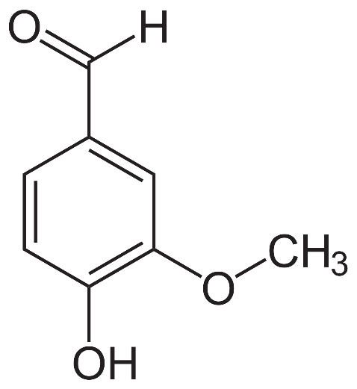
Vanilla flavor and odor compounds
Vanillin (see structure -> ) is the majority
Hydroxybenzaldehydes
Phenols
Alcohols
Some 130 other compounds contribute aroma and flavor
Photo by NEUROtiker via Wikipedia
Notes:
Vanillin is what is synthesized for use in imitation vanilla extract
http://www.celkau.in/crops/spices/Vanilla/vanilla_composition_and_vanillin_content.aspx

Slide 29
You right now (probably)

Slide 30
Benefits of homemade vanilla extract
High degree of control over ingredient quality
Customization options you can’t find in retail
Different regions of beans, different curing processes
Different liquor options
Brings excellent flavors
Easy gift

Slide 31
Downsides of homemade vanilla extract
Takes time, both to source ingredients and waiting for the extract to finish
Need to buy production materials
Costs more, costs fluctuate
Vanilla beans aren’t cheap. 1 pound of high quality beans cost $150-$175 retail (currently)
Allocating closet or cabinet space for significant time

Slide 32
Picking liquor
You can use anything with 35% or more ethyl alcohol
Vodka is most popular, rum and whisky are popular alternatives
Buy something good. It is going to make up almost all your extract!
If you don’t drink like me, just look to professional reviews or competitions
Should never have harsh smells
Notes:
Unfortunately if you don’t drink you just have to come up with something you can trust for getting an idea about if something is good or not
The $20-$30 range for 750ml bottles tends to have lots of good options

Slide 33
Picking beans
Grade B aka Extract Grade
Beans are like grapes or coffee beans; they take on qualities from their growing area
Vanilla planifolia originated in Mesoamerica and is still grown in that region in addition to Africa
Madagascar produces over half the world’s vanilla bean supply
Vanilla tahitensis are generally grown in Asia
Indonesia produces almost as much vanilla as Madagascar
Notes:
If you’re wondering how Vanilla plants got from Mesoamerica to Madagascar, it was French colonialism
https://www.worldatlas.com/articles/the-leading-countries-in-vanilla-production-in-the-world.html

Slide 34
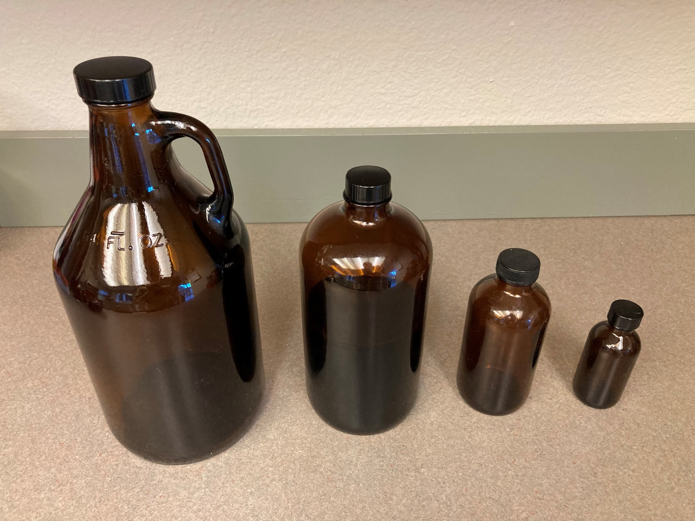
Bottling the fruit of your labor

Slide 35
Bottling tips and tricks
A 64oz bottle is a good size to use for the extraction/aging
Small enough to not be too difficult to store or very heavy
Large enough to easily fit a bottle of alcohol and the required amount of beans
I keep the beans whole because I find it easier to remove from the bottle
Use brown bottles
Polyseal caps not only seal very well but will last a long time. Don’t get damaged by moisture like foil caps.
Shipping sucks, try to find bottles locally

Slide 36
Derek’s easier to use recipe
750ml bottle of quality vodka (or whiskey, rum, etc)
2.645oz (75g) vanilla beans
- Or -
1.75l bottle of (or whiskey, rum, etc)
6.172oz (175g) vanilla beans
Combine whole beans and alcohol in large brown bottles. Store in a cabinet or closer. Agitate at least monthly. Keep stored for minimum of 6 months.
When ready to bottle, use funnel lined with cheese cloth that has been folded over 4 times. Using lined funnel, pour from aging bottles into measuring cup. Use measuring cup to fill final bottles.

